Slide 1




DAN 315326: Introduction to Data Analytics & Insights
Course Orientation and Fundamentals
Course Name: DATA ANALYTICS
Fifth Semester | Diploma (K Scheme) | Course Code: 315326
Programmes & Marks
Applicable to CM, CO, CW, IF, IH, SE, TE | Total Marks: 150
Instructor: Mr. Chatake A.S.
Welcome to an engaging journey into data-driven decision making!
Notes:
Welcome to DAN 315326 – your gateway into the world of Data Analytics. This course is strategically designed for Diploma students under the K Scheme and applies to several key programs including CM, CO, CW, IF, IH, SE, and TE. With a total evaluation of 150 marks, split across theory and practical's, you'll engage in hands-on learning and problem-solving.
In today’s digital era, data is the new oil. Whether you dream of designing smart applications, analyzing trends, or creating intelligent dashboards, this course will be foundational. You’ll learn not only tools like Python, Excel, and SQL but also the underlying logic and business acumen necessary to make sense of data.
Let’s dive into this journey with energy and curiosity. The concepts you learn here will serve you across multiple domains—tech, healthcare, logistics, marketing, and more. Get ready to explore!

Slide 2



Course Overview & Structure
DAN 315326 | Data Analytics – Quick Recap
Syllabus Breakdown
5 Units: Data Types, Statistical Analysis, Excel, Visualization, Python
Course Outcomes (COs)
Each unit aligned with measurable learning outcomes (CO1 to CO5)
Assessment Strategy
Theory + Practical (Internal/External) + SLA Projects = 150 Marks
Notes:
Let’s begin with a quick recap of the course orientation. DAN 315326 consists of five logically sequenced units that take you from data fundamentals to advanced visualizations using Python. These units are carefully aligned with distinct Course Outcomes (COs), so you'll know exactly what skills you're building with each module.
In terms of evaluation, the total 150 marks are divided into 70 for theory, 25 each for internal and external practicals, 10 for SLA projects, and 20 for class tests. This ensures a balanced focus on both your conceptual understanding and your technical execution skills.
Keep in mind that each assignment, micro-project, and lab task you complete feeds into this strategy. Whether it's exploring dashboards, formatting pivot tables, or creating Matplotlib plots, every hands-on element builds directly into your grade and understanding.

Slide 3

Today's Agenda
Overview of Key Learning Topics
What is Data?: Understanding raw data, its forms (structured/unstructured), and real-world examples
Types of Analytics: Descriptive, Diagnostic, Predictive, and Prescriptive analytics in context
Dashboards & MIS Reporting: How data is presented to drive insights and decisions
Photo by Lauren Sauder on Unsplash
Notes:
Today’s session is designed to build a rock-solid foundation in Data Analytics. We will begin with a simple but crucial question—what is data? You’ll learn to distinguish structured from unstructured data, using relatable examples like food delivery platforms.
Next, we’ll explore the full landscape of analytics—descriptive to prescriptive. You’ll learn how companies use analytics to understand what happened, why, what will happen next, and what they should do about it.
We’ll also cover MIS Reporting and Dashboards—powerful tools that make raw data digestible and actionable. Expect familiar real-world examples from YouTube, Swiggy, and Amazon. By the end of this session, you’ll be equipped with essential vocabulary and frameworks that you’ll use throughout the course.

Slide 4



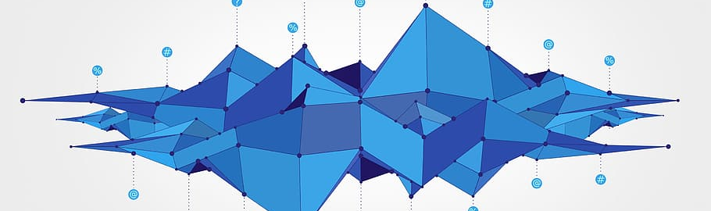
What Is Data?
Raw Information in Digital Form
Definition
Raw information — numbers, text, images, facts — collected from various sources
Types of Data
Structured (Excel rows, SQL tables) vs. Unstructured (tweets, images, audio)
Real-Life Example
Swiggy order data: item, time, restaurant, payment method
Notes:
Let’s begin with the most fundamental concept—data. In analytics, data is any raw information that can be observed, recorded, and stored. It could be a number, a sentence, an image, or even a user behavior pattern.
We classify data into two main types: structured and unstructured. Structured data fits neatly into tables or rows, like a spreadsheet or a SQL database. Unstructured data, on the other hand, includes things like social media posts, audio recordings, and videos, which don’t conform to conventional data models.
For instance, every order placed on Swiggy generates multiple pieces of structured data—what was ordered, when it was ordered, from which restaurant, and how it was paid for. At the same time, a customer review or a voice complaint may be examples of unstructured data. Both forms are essential in today’s analytics-driven ecosystem.

Slide 5

What Is Analytics?
Deriving Insights from Data
Definition: The process of examining data to identify patterns, trends, and insights
Key Questions It Answers: What happened? Why? What might happen? What should we do?
Real-Life Example: YouTube tracking views, watch time, and click-through rates
Photo by Lukas Blazek on Unsplash
Notes:
Now that we know what data is, let's discuss analytics—the heart of the data science process. Analytics is the examination of data to discover patterns, draw conclusions, and support decision-making. It's not just about numbers—it's about storytelling and logic.
Analytics helps answer four critical questions: What happened? Why did it happen? What might happen next? And what should we do about it? This makes analytics integral across all industries—from social media to e-commerce to healthcare.
Take YouTube, for instance. They use analytics to measure how many people clicked on a video (impressions), how long they watched (watch time), and where they dropped off. These insights help creators refine content, optimize thumbnails, and understand audience behavior better.

Slide 6

What Is Data Analytics?
Turning Raw Data into Decisions
Definition: The science of analyzing raw data to support informed decision-making
Core Components: Statistics, Programming (Python, R, SQL), and Data Visualization
Example Use Case: Amazon uses analytics to recommend products and forecast demand
Photo by Markus Spiske on Unsplash
Notes:
Now let’s tie everything together with Data Analytics—the complete process of turning raw data into actionable insights. It blends elements from statistics, programming, and visualization to help stakeholders make informed decisions.
The three major tools you'll encounter are Python, R, and SQL. Python and R handle computations and modeling, while SQL retrieves and manipulates data from structured databases. Visualization tools help translate all of this into readable charts, plots, and dashboards.
For example, Amazon uses data analytics to analyze browsing and purchase history. The platform then predicts what you might need next, whether it’s a charger for a phone you just bought or refills for products you reorder. This powerful personalization boosts user experience and sales.

Slide 7
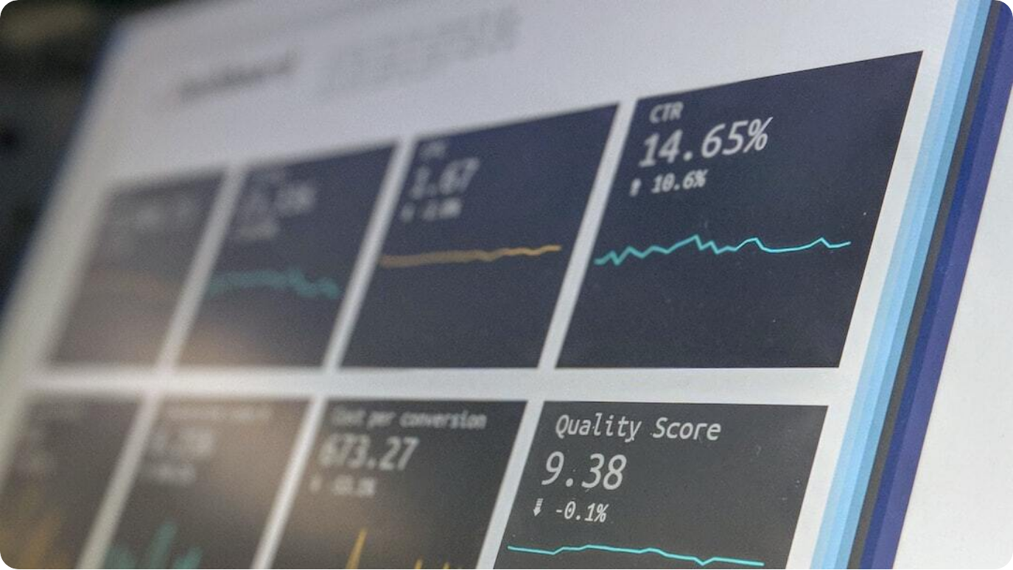
Types of Data Analytics
From Description to Prescription
Descriptive: Summarizes past data to understand what happened – e.g., Swiggy's monthly order count
Diagnostic: Explores reasons behind outcomes – e.g., YouTube analyzes drop-off rates
Predictive: Forecasts future trends – e.g., Amazon predicting customer purchases
Prescriptive: Recommends actions – e.g., Swiggy suggesting delivery route adjustments
Photo by Stephen Dawson on Unsplash
Notes:
To gain real value from data, we must ask the right questions. And each type of analytics answers a different kind.
Descriptive analytics helps us understand what happened in the past—like how many biryanis Swiggy sold last month. Diagnostic analytics looks deeper to uncover why something occurred—YouTube might analyze when viewers lost interest in a video.
Predictive analytics goes further, forecasting what might happen next. Amazon is a great example—they use it to predict your next likely purchase. And finally, prescriptive analytics suggests the best course of action. Swiggy might recommend changing delivery routes to reduce time and costs.
These four layers build upon each other and are often used together in comprehensive decision-support systems.

Slide 8

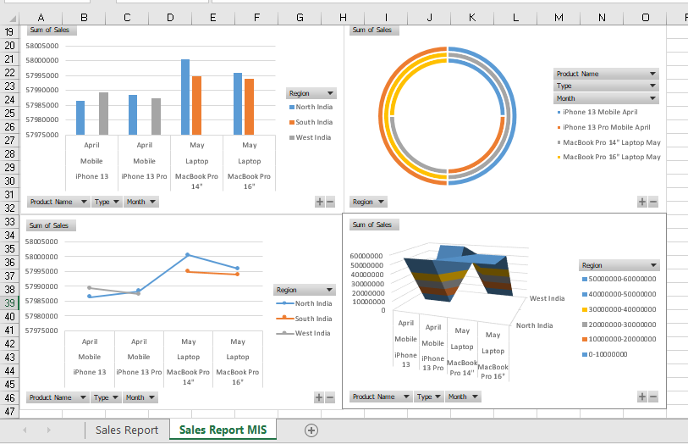


What is MIS Reporting?
Management Information System Reports
Definition
Structured reporting method to support business decisions
Common Types
Sales reports, inventory logs, financial summaries, customer feedback
Real-World Use
Swiggy managers track delayed deliveries through MIS reports
Notes:
MIS Reporting—or Management Information System Reporting—is essential for turning complex datasets into actionable insights. These are structured reports designed for decision-makers to monitor business operations efficiently.
Examples include daily sales summaries, current stock levels, customer satisfaction logs, and profit-loss statements. These reports are automated or semi-automated and updated regularly, offering a snapshot of business health.
At Swiggy, MIS reports help managers evaluate restaurant delays or driver performance. For instance, they might notice a pattern of late deliveries from a specific outlet and initiate operational changes. These insights are fundamental in improving business efficiency and customer satisfaction.

Slide 9


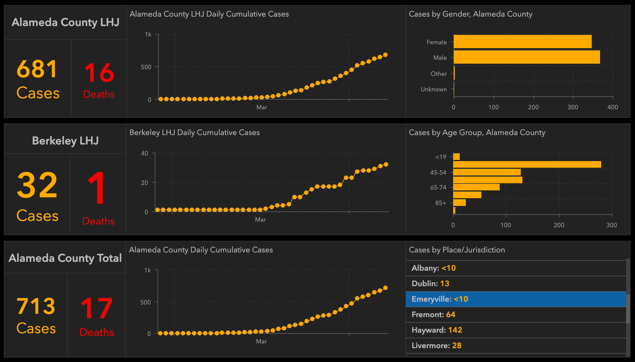
What Is a Dashboard?
Your Data Command Center
Definition
A visual interface showing key metrics and insights in real-time
Core Features
Interactive charts, KPIs, filters; often built using tools like Excel or Power BI
Examples
YouTube Studio or Swiggy dashboards showing views, ratings, orders, delays
This Photo by Unknown Author is licensed under CC BY-NC-ND
Notes:
A dashboard is like the cockpit of a jet—it lets you monitor everything that matters at a glance. In analytics, dashboards present key metrics visually so you can spot trends, anomalies, and performance issues instantly.
Most dashboards are interactive and real-time. You can filter by date, location, category, or user group. They often include visualizations like pie charts, bar graphs, KPIs, and timelines, helping users at all levels make data-informed decisions quickly.
For example, YouTube creators use dashboards to track views, watch time, and subscriber changes. Swiggy’s internal dashboards show real-time delivery metrics, customer feedback, and revenue trends—empowering quick action across operations.

Slide 10

YouTube Views Analytics
Using Data to Improve Engagement
Key Metrics Tracked: Impressions, click-through rate (CTR), watch time, audience retention
Purpose: Understand what content resonates and identify drop-off points
Content Optimization: Creators tweak thumbnails, titles, and length based on analytics
Photo by Szabo Viktor on Unsplash
Notes:
YouTube is a prime example of data analytics in action. Every video you watch generates a wealth of data—how often it’s shown (impressions), how many people click (CTR), how long they watch (watch time), and where they stop watching (audience retention).
These insights are not just numbers—they’re a roadmap for creators. If many viewers drop off early, perhaps the intro needs work. A low CTR? Maybe the thumbnail isn’t engaging enough. Creators use these signals to fine-tune content and keep audiences engaged longer.
From algorithmic recommendations to creator dashboards, analytics powers YouTube’s entire content ecosystem, making it both user-driven and data-centric.

Slide 11



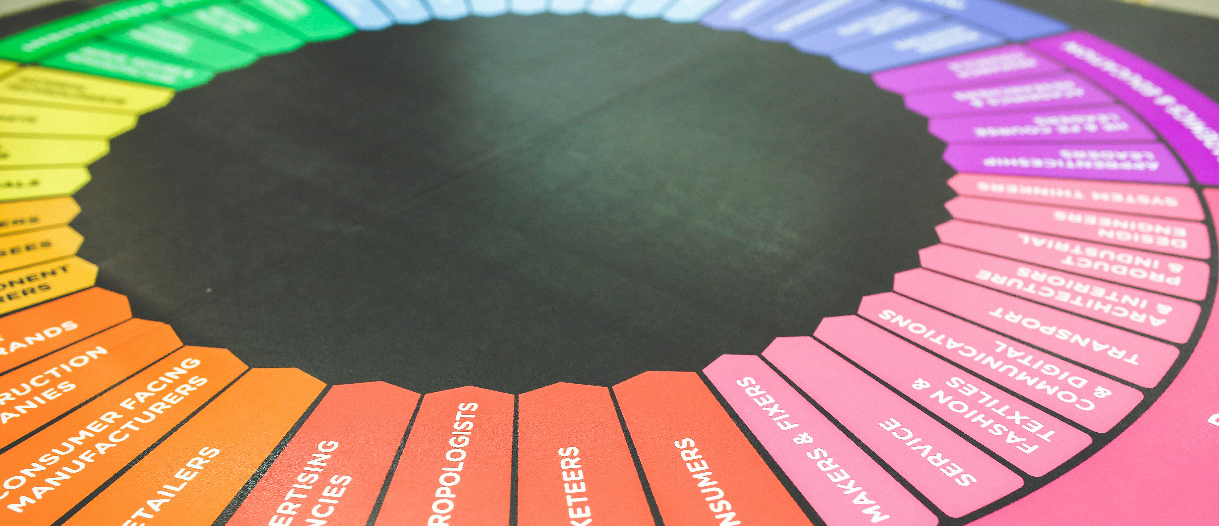
Swiggy Pattern Analytics
Understanding Customer & Operational Trends
Order Trends
What foods are popular at which times; e.g., weekend biryani spikes
Customer Behavior
Analyzing repeat orders, preferences, and reviews
Operational Efficiency
Monitoring delivery time, route performance, and ratings
Notes:
Swiggy leverages analytics to drive both customer experience and operational excellence. Every order tells a story—what’s being ordered, by whom, when, from where, and how frequently.
For instance, they might notice a surge in biryani orders on Fridays and Saturdays. This insight leads to targeted promotions or banner placement. Similarly, customer behavior data helps tailor recommendations and assess satisfaction.
From a logistics perspective, delivery time, route efficiency, and rider ratings are constantly tracked. If certain areas show delays, Swiggy can reallocate resources or optimize routing. In essence, data allows Swiggy to stay fast, relevant, and customer-centric.

Slide 12

Amazon Predictions
Forecasting Demand & Personalizing Experience
Product Recommendations: Suggesting accessories based on user history (e.g., phone → charger)
Demand Forecasting: Predicting sales volumes by location, season, and trends
Inventory Optimization: Minimizing stockouts and overstock via predictive algorithms
Photo by Christian Wiediger on Unsplash
Notes:
Amazon has mastered the art of using predictive analytics to streamline both customer experience and backend logistics. It starts the moment you browse a product. Based on your history and millions of similar users, Amazon instantly predicts what you might want next—be it a screen protector or a power bank.
Their demand forecasting engine uses time series data like historical sales, location, and seasonal cycles to estimate how much stock is needed in which warehouse. For example, umbrella sales spike in Mumbai during monsoon—and Amazon knows to pre-stock accordingly.
They also use real-time insights to optimize logistics, personalize ad placements, and automate pricing decisions. This is analytics at its most advanced—deeply integrated, customer-centric, and always learning.

Slide 13

Visual Analytics: Bridging Data and Decisions
Interactive Visualization in Modern Analytics
Definition & Scope: Visual Analytics combines automated analysis with interactive visual interfaces, empowering users to explore large, complex datasets intuitively.
Analytical Support: Enhances descriptive, diagnostic, and predictive analytics by translating quantitative outputs into understandable visual forms.
Tools & Technologies: Utilizes tools like Tableau, Power BI, D3.js, and Python’s Matplotlib and Seaborn for dynamic and real-time insights.
Business Applications: Enables real-time dashboards, operational KPIs, anomaly detection, and strategic forecasting across domains.
Photo by ThisisEngineering RAEng on Unsplash
Notes:
Visual Analytics is where analytical rigor meets human cognition. It integrates automated computations with powerful visual representation, transforming dense data into actionable insights. Whether it's line graphs showing sales trends or heat maps revealing customer churn, visual analytics bridges the gap between raw data and business understanding.
It significantly amplifies other analytics types. Descriptive statistics become accessible through dashboards; predictive models are validated visually for anomalies; even prescriptive decisions gain clarity when visualized over time-series or geospatial plots. This synergy empowers decision-makers to grasp key insights rapidly, even without deep statistical expertise.
Tools like Tableau, Power BI, and Python libraries bring these capabilities to life. From operational dashboards in logistics to interactive financial trend visualizations in fintech, the real-time visual analytics revolution is making data not just readable but actionable. Understanding this capability is foundational for any modern data analyst.

Slide 14
Data Analytics Life Cycle
From Raw Data to Strategic Decisions
Data Collection: Raw data is sourced from sensors, transactions, logs, and surveys using automated and manual pipelines.
Data Cleaning & Preparation: Identifying missing values, removing duplicates, and transforming formats ensure consistency and accuracy.
Data Analysis: Application of statistical, ML, or computational techniques to extract patterns and generate insights.
Interpretation & Decision-Making: Visualization and reporting of results for stakeholder understanding and informed decision-making.
Photo by Stephen Dawson on Unsplash
Notes:
The data analytics life cycle is a structured process that ensures data flows from raw formats to insightful outcomes effectively. It begins with data collection — harvesting relevant information from varied sources like transaction logs, IoT sensors, or user input.
Next comes data cleaning and preparation, arguably the most labor-intensive stage. Here, the focus is on resolving inconsistencies, handling missing values, and transforming data into analyzable formats. Tools like Excel, Pandas in Python, and SQL are central in this phase.
The heart of the process is analysis — leveraging statistical models, machine learning, or domain-specific computations. Finally, insights are presented visually and interpreted through dashboards and reports. This culminates in decision-making, where the value of analytics is realized across industries, from supply chain optimization to personalized marketing.

Slide 15

Data Quality, Quantity & Measurement
Foundation of Reliable Analytics
Data Quality Dimensions: Includes accuracy, completeness, consistency, timeliness, and validity—essential for trust in analytics.
Data Quantity Implications: Big Data introduces challenges in storage, processing, and noise reduction but also reveals rare patterns.
Measurement Standards: Defines how data is captured and interpreted—nominal, ordinal, interval, and ratio scales guide analysis.
Balance is Crucial: Excessive volume with poor quality or vice versa leads to flawed outcomes—optimal balance enhances insights.
Photo by patricia serna on Unsplash
Notes:
Data quality and quantity form the dual foundation of effective analytics. Quality refers to how reliable and trustworthy the data is—dimensions like accuracy, completeness, and consistency are critical. High-quality data ensures that the analysis reflects real-world patterns and not anomalies.
On the other hand, quantity deals with how much data is available. While large volumes can power powerful machine learning models and uncover rare trends, they also increase the risk of noise and data handling challenges. Effective data pipelines are necessary to handle high-volume datasets.
Measurement adds a crucial layer, determining how data is categorized and interpreted. Using proper measurement scales—nominal, ordinal, interval, or ratio—ensures analytical methods are correctly applied. In summary, optimal outcomes in analytics stem from the right balance between quantity, quality, and measurement precision.

Slide 16



Key Takeaways & Next Steps
Wrapping Up the Fundamentals
Understanding Data
Data comes in structured/unstructured forms and powers every digital process
Analytics Pipeline
Descriptive to Prescriptive analytics transforms insights into decisions
Preview of What’s Next
Hands-on labs, real-world datasets, and tool-driven analysis (Python, Excel)
Notes:
Congratulations! You’ve just completed a foundational journey through the world of Data Analytics. Today’s session introduced the concepts of data types, analytics frameworks, MIS reporting, dashboards, and their real-world applications.
You now understand how companies like Swiggy, YouTube, and Amazon use data to operate, grow, and serve customers better. You've also seen how the analytics pipeline helps businesses move from 'What happened?' to 'What should we do?'
In our next session, we’ll take these ideas from theory to practice. Be ready to work with tools like Excel, Python, and visualization libraries. From dashboards to decision trees, we’ll make the data come alive. Stay curious, stay analytical!

